Slide 1


1
Guidewire Cloud Program:
QA Strategy Update - Release 1 “Cirrus”
May 2024
Address: 15 Independence Blvd # 3, Warren, NJ 07059
Phone: (908) 604-2900
Prepared by: Accenture

Slide 2

Agenda

Slide 3
QA Strategy Update
QA Scope of Workers Compensation activities
ClaimCenter, ContactManager Upgrade v9 to Jasper
Claims Migration from Legacy systems to Jasper
Integration Impacts (New, Updated, Retrofit)
Billing Center impacts (Deductible Billing)
Claims Portal
Cross Product Validation (PC, BC, CC, CM, Digital Portals)
Timeline
QA Approach: GW Claims Upgrade v9 to GW ClaimCenter Cloud
QA Approach: WorkersComp LOB Configuration and Claims Conversion to GW ClaimCenter Cloud
QA Approach: GW Claims Integrations
QA Approach: Forms Testing
QA Automation Approach
Stabilization
NPE Planning
QA Methodologies
Testing Assumptions, Risks & Mitigation
Entry, Exit and Acceptance Criteria
Appendix

Slide 4
Scope & Timeline

Slide 5
MSIG /High-Level QA Scope & Out of Scope for Claims Migration
Claims Existing LOBs: Inland Marine, Business Auto, Commercial Property, General Liability, TPA Product Liability, TPA OTAI (also known as TPA Travel), Management Liability, Ocean Marine, Crime, TPA Ocean Marine, Excess Liability, Umbrella, Package, International Liability
Claims New LOB: Workers Comp (from iVOS, WINS)
QA Scope of Work
Configuration of new Line of Business implementation for Workers’ Compensation into Guidewire Cloud ClaimCenter
Follow the Minimum Viable Product (MVP) Approach as the existing R1 program and maintain 95% or more OOTB Code and functionality.
Utilize existing common functionality from ClaimCenter V9, only modify configuration where necessary for Workers’ Compensation line of business.
Workers’ Compensation Coverage configured for 50 United States
Handling of TPA Claims
Implement Guidewire Cloud Jutro Digital Portal
Conversion of existing Workers’ Compensation claims out of iVOS, WINS into Guidewire Cloud ClaimCenter
Upgrade of ClaimCenter V9 to GW Cloud ClaimCenter
SmartComm Forms Integration and Testing of CC forms
QA Testing and GT Automation
Performance testing of GW ClaimCenter
Additional Scope:
BillingCenter configuration for Deductible Billing
Integrations of Deductible Billing and External PAS to BillingCenter
Workers’ Compensation claims document testing
PwC & Guidewire Led
Downstream validation - Cloud Data Access & Data Warehouse &
CDA Testing
Other Areas – MSIG Led
Non-Guidewire legacy testing (iVOS, WINS)
3rd Party Vendor coordination during testing
Infrastructure / Cloud Environments during testing
Existing Document Forms Migration
Integrations in Scope: Listed in Slide6
Out of Scope
Any other legacy and integrations systems not mentioned as part of Claims conversion
Testing of Multi-currency
Testing Predictive Analytics
GW Archival testing of claims
Security testing

Slide 6
MSIG / Integrations in Scope
Integration pattern will be analyzed for each integration and derive the QA Test Approach
Testing team will devise a Test Plan at user story level to validate Component level, System Integration and End-to-End test cases are executed
New for Workers Comp | Updated for Workers Comp | Cloud Retrofit Only | EDP Feeds (CDA)
CC - PC | CC - WINS | Authentication | Clara analytics for Toyota
Document Production (SmartComm)*** | Document Storage (Laserfiche) | Email Integration | Tax Reporting
Medical Bill Review - Corvell | Legal Bill Review (Bottomline) | Special Handling Instructions*** | Unit Stat Reporting.
Medical Bill Review – Genex (TBD) | CC – ContactManager(will include location codes***) | Number Generation | GL
Deductible Billing*** | ISO Claim Search reporting(?-TBD) | One Inc. Payments*** | Risk Console
TPA error correction and Feeds (RiskConnect)*** |  | Police reports (Metro) | RiskConnect(TPA Outbound claims feed)
FROI/SROI using Verisk Accelerator** |  |  | RiskConnect Toyota feed
Contact Manager – DMS (Laserfiche) |  |  | PolicyFeed for TPAs
 |  |  | PolicyFeed for Actec
 |  |  | Corvel Balancing report
** Cloud version of accelerator available in August
*** Will need support all LOBs

Slide 7
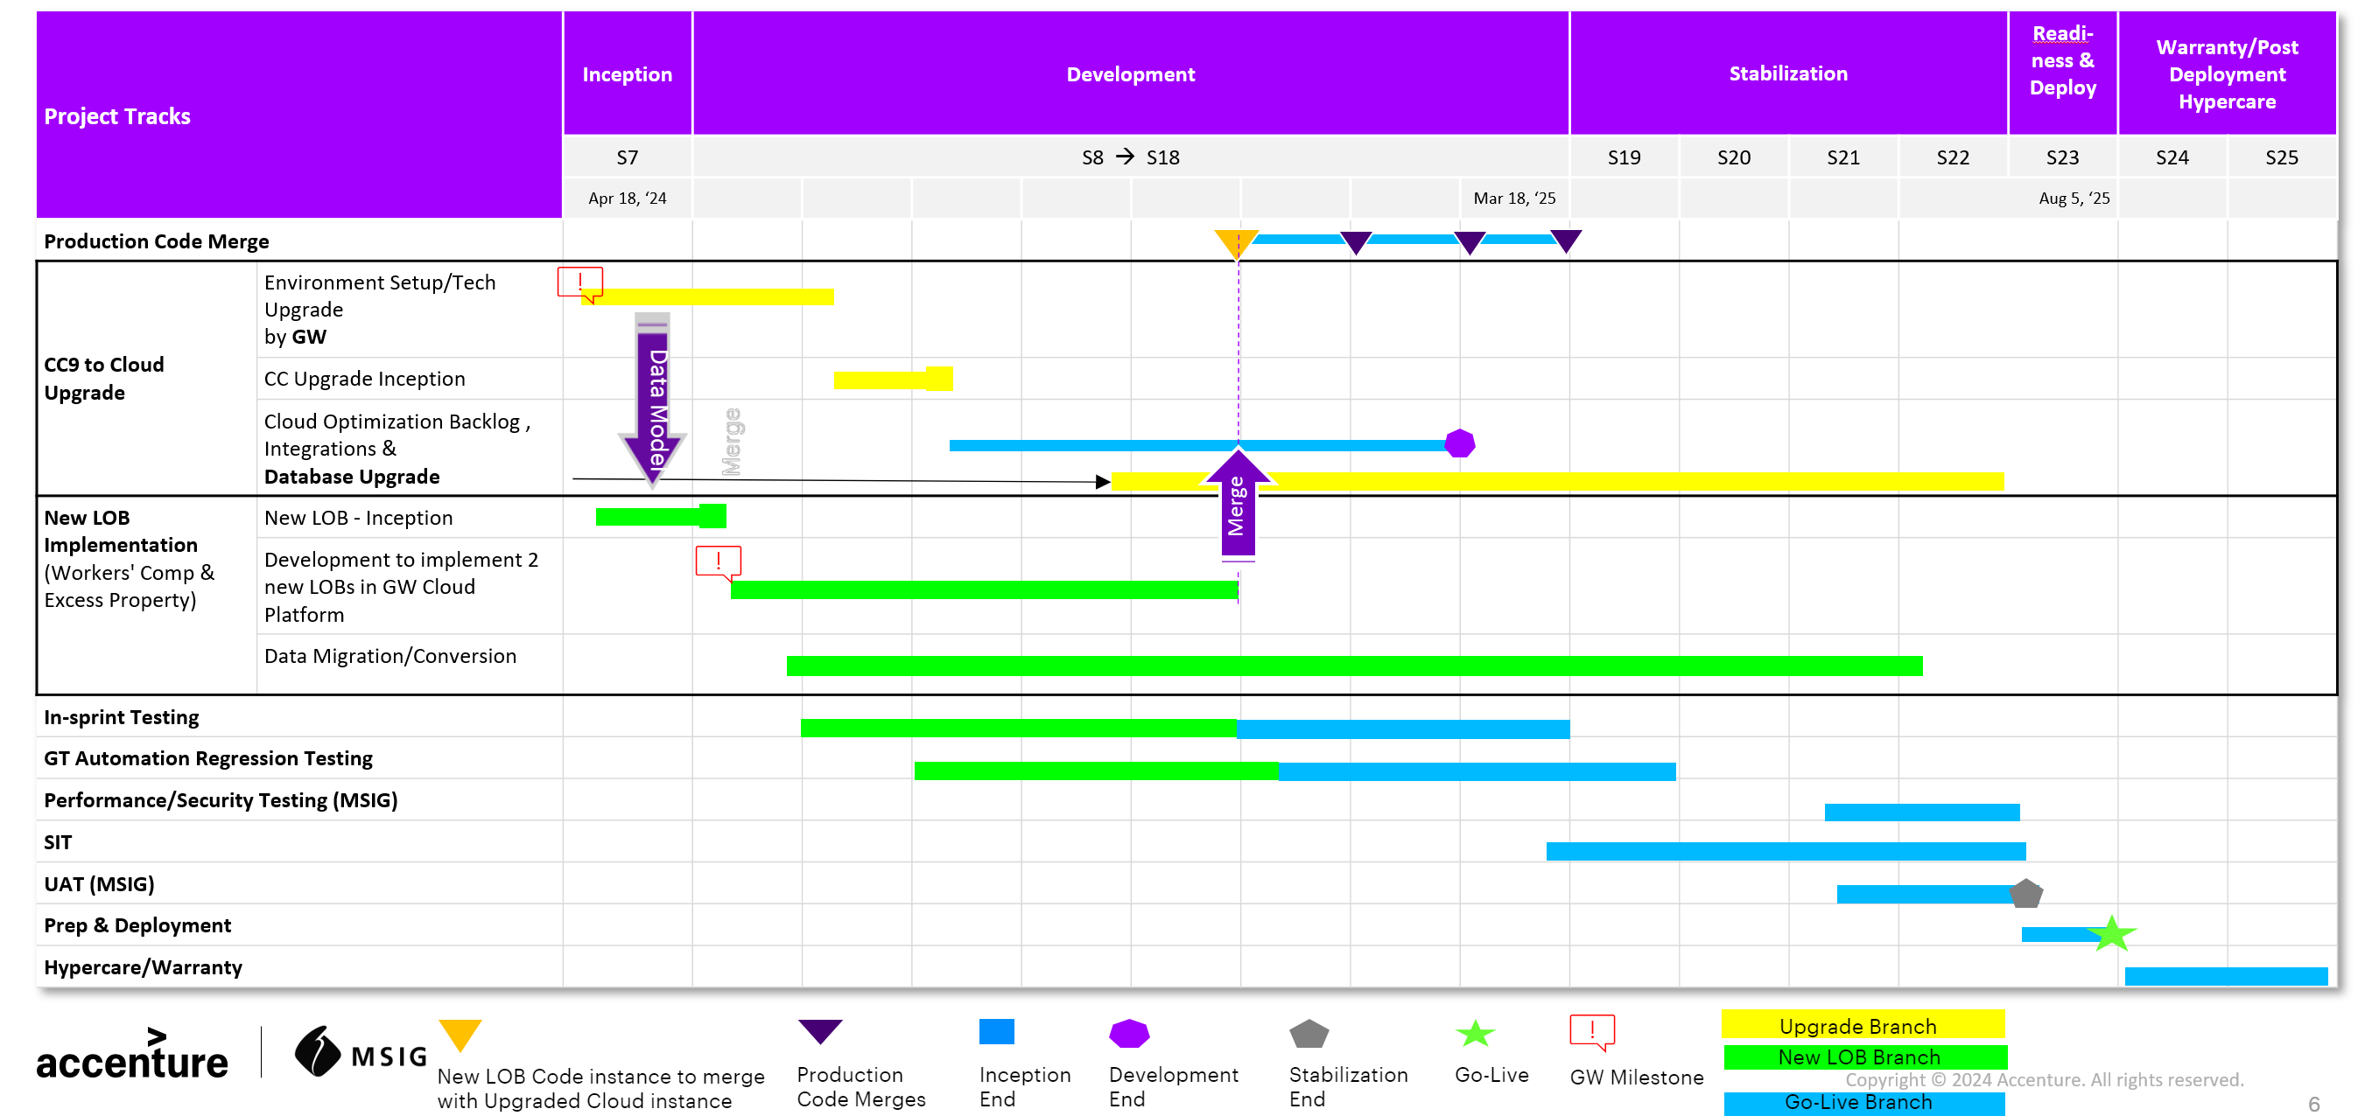
MSIG /High level Timeline

Slide 8
MSIG GW Claims Upgrade: v9 to ClaimCenter Cloud

Slide 9





MSIG / GW Claims Upgrade v9 vs. ClaimCenter Cloud – Parallel testing
Create a claim*
Guidewire CC, CM v9
* Pick the most used business transactions for each LOB
Inland Marine
Business Auto
Commercial Property, General Liability
TPA Product Liability
TPA OTAI (also known as TPA Travel)
Management Liability Ocean Marine
Crime
TPA Ocean Marine
Excess Liability
Umbrella
Package
International Liability
States:
KY, CA, MA, TX, NY, IL – Risk Based testing
Compare claim screens v9 vs. CC Cloud
Process a claim through all interfaces and transactions
Compare output of UI screens v9 vs. CC Cloud
Create a claim*
Guidewire CC, CM Cloud
(Jasper release)
Create similar Claim transactions for a given business function in V9 and GW CC Cloud
Example: Validate FNOL process, Adjudicate a claim and make single/multiple payment(s) to vendors
Compare screen data elements between on-prem V9 and GW CC Jasper Release
Validate removed MSIG ClaimCenter features if any applicable from V9
Validate customized features in the latest GW CC Jasper Release
Validate Business rules, Admin data (example: Users, Roles, Reserve, Authority Limit) as per the MSIG requirement
Run Automated regression scripts (GT Automation) against the latest GW CC Cloud
Risk based testing will focus on priority states KY, CA, MA, TX, NY and IL for the upgrade tests
Validation of Claims should continue in ClaimCenter, ContactManager for all 50 US states

Slide 10
MSIG /QA Approach for Claims Upgrade to Jasper
Test and Defect Management – Azure Dev Ops
Test Execution – Automated tools for Migration, Forms testing, Manual & Automated QA Approach
Testing Tools
Test and Defect Management – ALM/Any tool used by MSIG Financial
Test Execution – SQL scripts and reports
Testing Tools
Functional Testing
Regression
Testing
Regression
Testing
Database Testing
Functional Testing
System &
Integration Testing
Premium
Validation
System &
Integration Testing
Downstream,
E2E and UAT
Downstream,
E2E and UAT
Test
Phase
Test
Phase
Validation of GW v9 Claims to ClaimCenter Cloud (Jasper) ski release
Testing to meet the Guidewire Cloud Standards (Features of ski releases, substantial changes from on-premises)
Total # of Claims Count for in-scope LOB’s matching GW v9 and ClaimCenter Cloud per LOB
Claims & Contact Manager UI screens & details (i.e., status, LOB, subrogation and salvage claims payment, vendor details, coverages, exposure or reserve buckets, incidents, recoveries etc.,) matching between GW v9 and ClaimCenter Cloud
Verify the Line of Business involved in the upgrade process are available in the new ski release of ClaimCenter
Identify all integration points that need to be validated, particularly those that may behave differently in Cloud Environment, such as APIs, legacy and third-party integration and data exchange patterns
Support Document Management and Forms Integrated with SmartComm is working, for migrated claims metadata
Validation of Critical Business Test Scenarios & relevant Table impacts in Subsequent Sprints
Focus is to validate upgrade of test cases pertaining to subsequent changes
Focus on data accuracy and completeness of data.
Key focus areas will be record count check, data validation, table attributes validation like column name check, Orphan record check, data integrity validations
Testing of End-to-End Business Process across applications (to be conducted by MSIG Claims Financial Teams)
Validation of Claims Life cycle as per MSIG requirements in the ClaimCenter Cloud (Jasper) ski release
Parallel testing performed to ensure ClaimCenter, ContactManager v9 vs. GW ClaimCenter Cloud produces similar output
Testing to be done at field / screen level validation (UI) and at the business function level
Provide Test Co-ordination and planning support during Downstream, E2E and UAT
Test
Focus
Test
Focus

Slide 11
Workers Comp Configuration Testing
(CC, CM Impacts)

Slide 12
MSIG /QA Approach for Workers Comp Configuration CC, CM Impacts
Test and Defect Management – Azure Dev Ops
Test Execution – Automated tools for Migration, Forms testing, Manual & Automated QA Approach
Testing Tools
Test and Defect Management – ALM/Any tool used by MSIG Financial
Test Execution – SQL scripts and reports
Testing Tools
Regression
Testing
Functional Testing
Regression
Testing
Functional Testing
System &
Integration Testing
System &
Integration Testing
Test
Phase
Test
Phase
Testing to meet the Guidewire Cloud Standards for WC Config and Integration impacts (Features of ski releases, substantial changes from on-premises)
Claims & Contact Manager UI screens & details (i.e., status, LOB, subrogation and salvage claims payment, vendor details, coverages, exposure or reserve buckets, incidents, recoveries etc.,) meet requirements in the GW ClaimCenter Cloud - For example Record only impacts to CC and mimicking IVOS, Future handling of CM to hold vendor management
Payment and Vendor management functional impacts
Identify all integration points that need to be validated, particularly those that may behave differently in Cloud Environment, such as APIs, legacy and third-party integration and data exchange patterns
Integration of CC-CM, Document Management, Document Production for WC
Forms Integrated with SmartComm is working, for the new Configuration and Integration changes
Payment integration impacts
Vendor management integration impacts from iVOS to CM
Validation of Critical Business Test Scenarios in Subsequent Sprints
Focus is to validate new UI Screen changes to fields, of test cases pertaining to subsequent changes
Test
Focus
Test
Focus

Slide 13
MSIG Claims Data Conversion Architecture

Slide 14
MSIG / Claims Data Conversion Layer Based QA Approach
Transform (Automated Transformation)
Load
GW Cloud
Extract
Data Load in Target Layer
Source
(iVOS , WINS)
Data
Transformation
Curated Layer
CMT_IN
GWCP
Data Audit
Validation & Data Cleansing Reports
Extraction of Source Data
Data Mapping
Load via
GW DUT
CMT_OUT
Recon of Source
and Target
Reconciliation Report
Extraction of Source Data
Understand the full target ecosystem.
Identification of Data.
Identify generic data patterns
Identify components that cannot be migrated.
Write common/reusable Extraction scripts.
Output: Content inventory and Data extracted as per agreed scope.
QA Activity: Analysis of Source Data
Data Mapping
Review/Modifications of standard templates.
Establish data lineage practices.
Update mapping document per Source system.
Review and freeze.
Output: Signed off mapping documents.
QA Activity: ETL Test cases, ETL Scripts for Source to Target, Target to Source
Data Cleansing
Ensure validity, completeness, duplicity and accuracy
Standardize the data at the point of entry.
Implement automated data cleansing tools.
Output: Cleansing rules and activities, clean data for Transformation
QA Activity: Analysis of data profiling and results
Transform
Data Profiling/Data analysis post transform
Reconciliation and Verification.
Job automation
Ensure process efficiency
Reusable ETL frameworks
Output: Clean loaded and transformed data, success and exception reporting.
QA Activity : ETL Test Execution & Test logs
Recon and Validation
Recon between staging and target staging layer.
Reverse recon between target staging layer and target DB.
Validation of Migrated Data via Scoring rules of MSIG.
Output: Successful loaded/transformed data. Error reports.
QA Activity : ETL Test Execution, Test logs, Defect reports

Slide 15
MSIG / Claims Data Conversion QA Approach….. Contd…
Layer based testing Approach will be adopted with following QA validations (listed in below table)
Data conversion testing will be carried across various layers: Source -> Staging -> ADLS (Raw & Transformed) -> CMT In & CMT Out -> GW CC
Source to Target and Target to Source data validation will be performed to ensure data integrity is met
Documents/Forms metadata will be included as part of Data Migration
Reconciliation | Data Validations | Referential Integrity Checks | Audit Balance Checks | Business Validation
Record Count: Ensure the completeness of the claims load (using the Record count) across different layers | Validate the direct move, default values expected from Source to Target, validate both Source-Target and Target – Source | Validate violation of parent child relationship among entities across layers | Length Check: Validate the length of each value for a given variable is as expected | Validate Claims business and workflow scenarios across layers
Reconciliation of financial and non-financial parameters Example. Claim amount, claim no, loss type, incident details | Validate the auto-generated key fields and check for the logic of various fields population | Verify foreign key columns population logic | Pattern check: Validate that the type of each value for a field is as expected | Validate the claims business workflow and financial (loss metrics) data on the GW CC UI Screens
Claims Business report summary and detail measures validation | Validate transformation rules and ensure that the specific business rules and aggregations are implemented accurately |  | Not null check: validate if null values exists for a mandatory field | Reference typelists added as part of CC scope in UI Screens
 | Validate the sequence number/surrogate key generation logic |  | Uniqueness check: Validate that there is no duplicate for the given combination of fields
 | Reference Typelists validation |  | Audit Field validations and error log checks
 |  |  | Domain Check: Validate that the value of a given field lies in a pre-defined domain (Master data)
Technical KPIs
Total number of policies Total number of Claims Total number of Loss transactions (Reserve, Recovery) Total number of Claims by LOB Total number of Claims per Status Total number of Claims per segment (loss type, CAT code*) Aggregated amount of the payment per claim Total amount of the reserve per claims | Total number of coverages per claim Total number of incidents per claim Total number of exposure per claim Total number of Risk unit per claims Total amount recovery per Claim Total amount of the recovery reserve per claim Deductible billing – historical data TPA errors – historical third-party errors Claims Financials – Year wise
Functional KPIs
Percentage of Data Quality Failure, Data Quality Rejection Count Percentage of Records Migrated Successfully, Records mismatch count File Count, Row Count, Time Taken for each step and table Status for each step and table (Success/Failure) Start time & End time on each step and table Error messages on each step, in case of any failures
Balancing Reconciliation metrics will include validation of:
Simple record counts check for each table to keep track of whether the Targeted number of records have migrated or not
Compare SUM of measure fields between Source and Target (CMT, In/Out)
Compare individual transactions between Source and Target (CMT, In/Out)
Validate any new additional KPIs, Claim financials w.r.t Workers Comp LOB

Slide 16
MSIG Claims Data Validation vs. UI Screen Validations

Slide 17
MSIG / Claims Data Validation vs. UI Screen Level validations (Model)
Claim Registration/FNOL
Claim Registration/FNOL
Investigation and Assessment
Reserve Allocation
LOSS DETAILS
Summary ,Exposure ,Loss Details
LOSS DETAILS
New Claim Wizard
Summary ,Exposure ,Loss Details
New Claim Wizard
WORKPLAN
Special Investigations
WORKPLAN
FNOL Details
Special Investigations
FNOL Details
Claim Details, Loss Details, Exposure Details ,Parties Involved, Planned Actives
Claim Details, Loss Details, Exposure Details ,Parties Involved, Planned Actives
Investigations Details
CC_NOTES
Investigations Details
CC_NOTES
Litigation / Matter
Litigation
Policy /User/ Coverage Verification & validation
Policy /User/ Coverage Verification & validation
CC_MATTER
CC_PLAINTIFFARRAYEXT
CC_DIFFENTSARRAYEXT
CC_CLAIM
CC_INCIDENT
CC_POLICY
CC_COVERAGE
CC_CONTACT
CC_CLAIMCONTACT
CC_ADDRESS
CC_EXPOSURE
CC_ACTIVITY
CC_VECHILE
CC_RISKUNIT
CC_CLAIMCOTACTROLE
CC_VEHICLEOWNER
CC_MATTER
CC_PLAINTIFFARRAYEXT
CC_DIFFENTSARRAYEXT
CC_CLAIM
CC_INCIDENT
CC_POLICY
CC_COVERAGE
CC_CONTACT
CC_CLAIMCONTACT
CC_ADDRESS
CC_EXPOSURE
CC_ACTIVITY
CC_VECHILE
CC_RISKUNIT
CC_CLAIMCOTACTROLE
CC_VEHICLEOWNER
Claims Migrated Data vs. UI Screen Validation
Claims End to End business validation will include comparing migrated data the Target DB and their corresponding screen in CC and CM UI For example. CC_INCIDENT can have vehicle, property incidents tagged to claim, and their transactions being validated across Loss Details >> Incident screen Claim workflow validation will be covered during in-sprint, integration and End to End testing to test the claim financials (loss amount, reserve, recovery etc.,) List of working iVOS tables below
CC_TRANSACTION
CC_TRANSACTIONSET
CC_TRANSACTIONLINEITEMS
CC_RESERVELINE
CC_TRANSACTIONOFFSETONSET
CC_SALVAGEEXT
CC_SUBROGATIONSUMMARY
CC_TRANSACTION
CC_TRANSACTIONSET
CC_TRANSACTIONLINEITEMS
CC_RESERVELINE
CC_TRANSACTIONOFFSETONSET
CC_SALVAGEEXT
CC_SUBROGATIONSUMMARY
CC_CHECK
CC_CHECKPAYEE
CC_CHECK
CC_CHECKPAYEE
CC_RECOVERYCHEKEXTY
CC_RECOVERYCHEKEXTY
Payment Transactions
Recovery Details
Payment Transactions
Recovery Details
Transactions
Transactions
FINANCIALS
SUBROGATIONS
FINANCIALS
SUBROGATIONS
FINANCIALS
FINANCIALS
Negotiation Settlement & Recovery
Closure
Payment Process
Negotiation Settlement & Recovery
Closure
Payment Process
https://msighusa.sharepoint.com/:f:/s/GuideWireCore/EhQhzMszoFtIvrbN2-oKknEBXwoTQxptNnxuUglWekeNng?e=6nTred
SCREEN INVOLVED PROCESS INVOLVED TABLES INVOLVED
SCREEN INVOLVED PROCESS INVOLVED TABLES INVOLVED
1
2
3
1
2
3

Slide 18
MSIG Core Contextual Integration Architecture

Slide 19
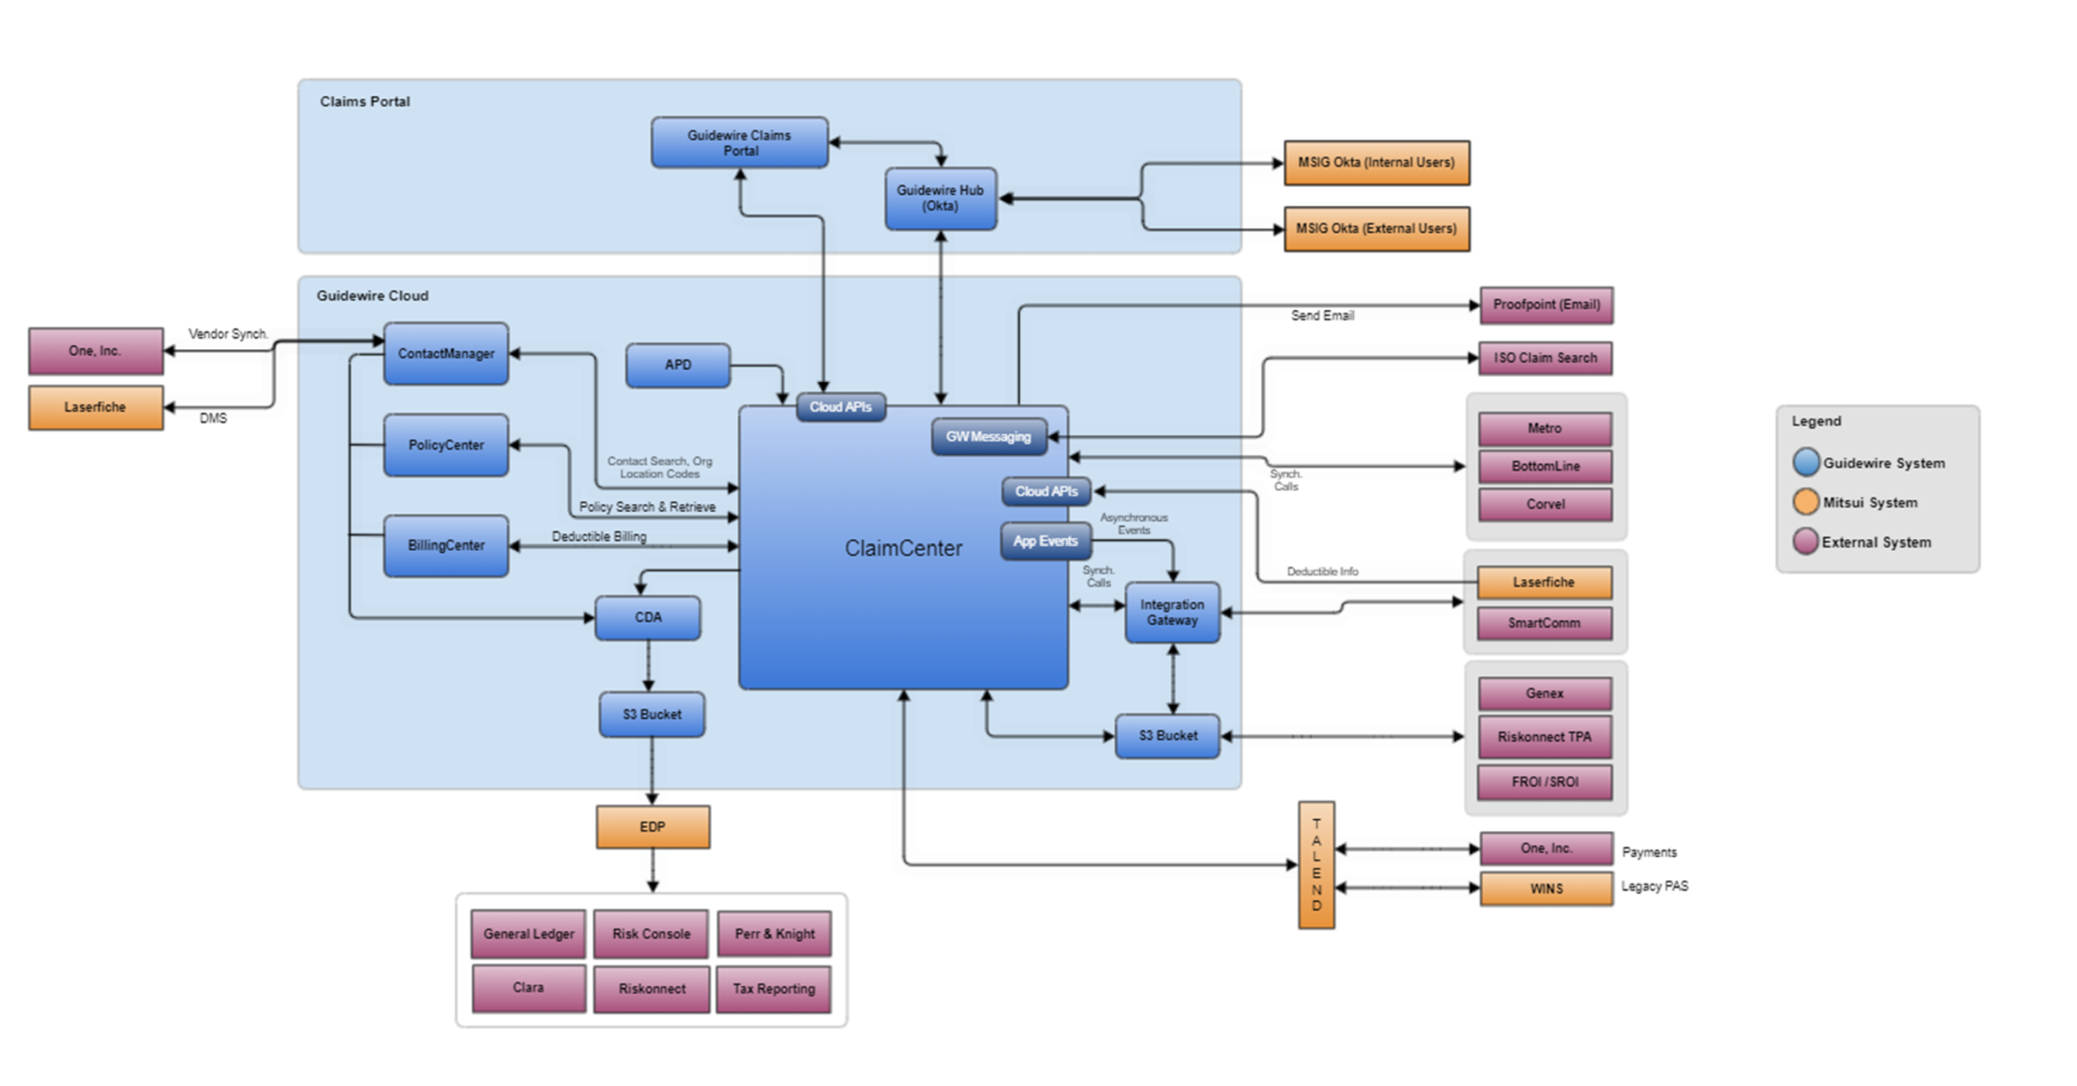
MSIG / GW InsuranceSuite Functional & Integration Architecture

Slide 20
MSIG / Integration Points between Guidewire xCenters
High-level Scenario flow across applications
Testing performed at user story level where one or more integration could be tested as part of a user story testing during the development sprints.
Either Manual or automated Approach will be leveraged. Tools include SOAPUI, Postman, GT: API component will be used to perform integration testing to validate the communication between Guidewire applications and external systems.
Following techniques are used during integration testing:
Inbound and outbound integration points between ClaimCenter (including PolicyCenter, BillingCenter) and other external interfaces
Validation using stub/mock data where the integration is not readily available for QA validation
Functionality customization, forms and output validation, and dynamic data validation across functionalities / integration
Scope of integration testing can be classified into 2 parts:
Guidewire Cross Product Integration – That connects its core applications with each other, such as GW CC with GW CM, GW PC with CC, GW PC with BC, Digital Portals with GW CC
Guidewire Integration with other internal/external systems – The other integration is between the Guidewire core application with MSIG Client Legacy specific, Guidewire BBG and 3rd party vendor applications (Ex: Authentication Single-Sign on, BBG Accelerator, Enterprise, ISO ClaimSearch etc.,)
Digital Portal
Claims Portal
PC
Rating\Underwriting\forms
BC
Deductible Billing
Issuance
Transactions
Rules
Invoice
Payments/ Delinquencies
Collections
CC
Payment/Recovery/Checks/Forms
FNOL
Adjudicate
Settle & Close
Internal & External Integrations
FNOL
CM
Vendor
Critical Path Approach will be utilized for validation of LOBs. Life cycle validation will subject a policy to flow through various stages, from Issuance to cancellation\Renewal, Claims till Closure, Invoicing to Collections process, similar to a real time business flow to ensure no anomalies are observed
Testing encompasses all in-scope integrating applications which will be part of Policy\Billing\Claims\Contact Manager lifecycle as part of MSIG business process
Ensure maximum end-to-end test coverage for all the critical Insurance Business transactions for stamping the quality of the product

Slide 21
Forms Testing

Slide 22
Forms QA
ClaimCenter Forms testing will include (1) Inference logic validation (2) Payload (3) Static and dynamic content validation.
Forms testing will be done for applicable Claims transactions include Payment, Reserve change, Recovery and Claims Summary etc.
Document forms testing should meet Compliance, Accuracy, consistency, notifications etc.
Document Comparison Tool will be leveraged for Document Forms testing
Forms Test Execution Approach: Forms testing will be carried out in three phases based on code-delivery.
Draft phase (forms not completely developed)
When static forms should have been developed and frozen; dynamic forms are developed partially with release notes, then QA team will perform inference logic validation, forms format validation, static and dynamic content validation for the delivered items partially. Regression test cases will need to be identified and QA backlog will be revisited for any undelivered items.
Final phase (forms - completely developed)
When static forms are developed and frozen; dynamic forms are developed and frozen, then QA team will perform validation on format, static and dynamic validation. Regression test cases will need to be executed and QA backlog will be revisited for any undelivered items identified earlier and executed.
State approval
When static forms are developed, dynamic forms are developed and state approval received for all applicable forms, then QA team will perform test execution that has undergone changes during state approval phase for business trigger condition, design and layout, static and dynamic content. A risk-based Approach will be followed to test countrywide and state-specific forms as part of regression.

Slide 23
MSIG Claims Automation Approach

Slide 24





MSIG / Claims Automation Approach
The Approach for Claims Automation will adopt a 5-step process to deliver the automation deliverable
Leverage GT++ accelerators and use Guidewire Testing Framework to build CC automation scripts
Implement CI/CD pipeline using TeamCity to automate testing of new functionality changes
Test data management will play a key role to include migrated claims data, new business claims
GT++ GT UI Test cases for OOTB LOBs whatever Accenture Guidewire Team be leveraged
Hyper GT API automation to create GT API test cases automatically
Use GT UI Hyper automation whatever completed till date
Delta LOB GT UI testcases - build using QA Automation folks
Feasibility check: Leverage existing Selenium CC Automation Scripts

Slide 25
Stabilization

Slide 26
MSIG / Stabilization Phase – Claim Lifecycle & E2E Testing
FNOL / Intake
Assign
Claim
Assess
Damage
Investigate
Claim
Evaluate
Claim
Resolve
Claim
Recover
Damages
Settle / Close Claim
Recover
Damages
Objectives
Validate that the ClaimCenter can perform business process flows and integrates seamlessly with both internal and external interfacing applications
To test the complete claim process in an environment which is like production in transaction processing set up
Also to validate all the Claim functionalities based on third party application’s request and response
End to End with Integrations: Claims data will include respective LOBs with (1) Migrated Claims from Legacy (2) New Business Policies (3) New Business Claims (3) Migrated Policies from Legacy and their respective Claims (4) Contact Manager (5) Internal/External Integrations to perform an End-to-End Cloud integration
Claim life cycle validation will subject a claim to flow through various stages, from FNOL to Closure, like a real time business flow to ensure no anomalies are observed
Various transactions will be performed in ClaimCenter for the policies from Guidewire PolicyCenter and validating the integrating applications. The response from the external systems will be validated within ClaimCenter
Critical Path Approach will be utilized for schedule definition. Analyze, Design, Prioritize and Execute the critical end-to-end business critical scenarios
Claim forms will be validated and which will be identified based on the complexity and most used as per the business transactions. The content of the OnDemand documents both Static and Dynamic forms will be considered.
Approach

Slide 27
MSIG Claims Migration – NPE Planning

Slide 28
MSIG / v9 to ClaimCenter Cloud: NPE’s Planning
Leverage a dedicated dev, qa planets for upgrade development and testing
Setup cloud test environment to closely replicate production environment in terms of data, user load, and third-party integrations
Protect sensitive data and personal data in test environment, include data masking and anonymization
Planet | Existing / New | Purpose | Upcoming Strategy
dev | Existing | Used by GW developers for coding and unit testing | Enable for ClaimCenter config development and unit testing
qa | Existing | Used by Testing team and all integrations point to this qa planet | Enable for CC Config testing and CC integrations to the same qa planet
devmigr | Existing | Used by GW developers for policy migration
qamigr | Existing | Used by Testing team for policy migration validation
qahub | Existing | Used by QA automation team
devta | Existing | Dedicated time travel environment for DEV, BA
qata | Existing | Dedicated time travel environment for QA
devrating | Existing | Dedicated for development rating changes
sandbox | Existing | Sandbox environment
claimsupgrade | New | Will be used for GW v9 Claims On-Prem to GW Cloud (Jasper) upgrade validation | Spin up for claims upgrade validation Next steps: To discuss with John W – how soon we need it?
devccmigr | New | Will be used by GW developers for claims migration | Spin up for ClaimCenter migration development and unit testing
qaccmigr | New | Will be used by Testing team for claims migration validation | Spin up for ClaimCenter migration qa validation
<TBD> | Claims Portal | For validation of Claims portal | Use new Jutro framework for Claims Portal.
CDA |  |  | Team to request specific mount point with Guidewire for Claims Migration

Slide 29
MSIG Claims Migration – QA methodologies

Slide 30
MSIG / Test Methodologies
QA methodologies and Program Level Test Process will be extended for the ClaimCenter Workstream
Azure DevOps (ADO) will be leveraged as Test Management tool for Claims Migration project
Bug tracking will be done in ADO
Build and Deployment process will follow similar Approach and extend deployment of ClaimCenter config code in dev and qa planets
ClaimCenter folder will be created for tracking QA artifacts (Test Design, Execution & Logs) under Quality Assurance Teams Channel
Claims Automation sprint planning, tracking and closure will adhere to the similar Guidewire standards to meet acceptance criteria; Backlogs will be discussed during sprint start and prioritized for subsequent sprints

Slide 31
Testing Assumptions, Risks & Mitigation Plan

Slide 32
MSIG / Testing Risks & Mitigation Plan
S# | Risk/Issue | Mitigation/Action Plan
1 | Risk of additional data conversion scope added for Data Conversion testing | Any additional scope will go through a change management process and mutually agreed between MSIG and Accenture Teams.
2 | Risk of Environment availability during Test execution phase | Planned downtime to be informed earlier during the Testing team, Accenture QA team will log the downtime hours and periodically update MSIG for strategic action.
3 | Risk of test data availability for Data Conversion test execution | SMEs to support during the Test data creation and data loaded for the LOBs by respective teams for Data Conversion testing on testing environments
4 | Risk of completion on retesting of defects | Accenture test team to closely work with development team by conducting defect triage meeting along with Stakeholders for defect prioritization and retesting.
5 | Risk of production data load available with all LOBs | Request for production cut with all LOBs to MSIG Legacy team
6 | Risk of VDI connectivity failure during SIT execution | 1. Maintain the downtime log and publish on a regular basis. 2. Request for additional time accordingly.
7 | Risk of Functional team working in parallel with SIT execution may uncover existing data defects | Defects raised during Cycle 1 will be retested in Cycle 2 or subsequent cycles.
8 | Risk of fixing and deployment the defect fixes on time due to technical constraints. | 1. Conduct Defect triage meeting on a regular basis and discuss the SLA for fixes and retest. 2. Any deferred bug will be noted and published in Test Metrics report.

Slide 33
MSIG / Assumptions & Dependencies
Current CC, CM version 9 is considered as baseline for validating GW CC,CM cloud
Validations between CC, CM v9 and CC, CM Cloud are performed at the business function level and not the individual requirement level.
Parallel testing will be carried out to ensure all elements in CC, CM v9 are successfully moved to CC, CM Cloud Jasper and E2E business process are working as expected in v10
All the integrations will be tested only with real time integration through UI
CC, CM v9 working systems will be available throughout testing lifecycle
OOTB CC, CM Cloud version will be available for comparison during testing
Third party vendor integration systems for Integration testing will be up and available in test environment throughout the testing life cycle in both CC, CM v9 and CC, CM Cloud
Legacy test data will be available in the NPEs
Migrated production data to be made available (after masking sensitive information) to lower environments
Test policy data requested by QA team will be made available by policy teams
Existing functional, integration and regression test cases will be used as starting point and those test cases will be updated as needed to match current flow
MSIG SME’s will be available for any outstanding clarifications and questions
Each story is developed, and unit tested by development team before it’s made available for the QA team to start testing
All identified defects in a sprint will be fixed within the timelines or SLA’s. If not, they will be added back to the product backlog and resolved in any subsequent sprints based on its priority
For each sprint, requirements and acceptance criteria will be finalized before the start of the sprint. If any requirements /Acceptance criteria must undergo the change during the sprint, the change will be accommodated in the same sprint based on reprioritization of the other requirements considering the available capacity
CC, CM Cloud Production mimic test environment will be provided to testing team
No changes will be made to any test environments (including configuration or code changes) without prior notice to testing team
The build supplied for release to production is the same as the build tested in the final cycle
Creation of UAT plan, test design for UAT, test execution, UAT sign off will be owned by the MSIG business team
Design/Development strategy is reviewed with the test team
Requirements/Mappings documents are reviewed with the test team
Any changes in the project plan or requirements will be communicated and Change control observed

Slide 34
Entry, Exit & Acceptance Criteria

Slide 35
MSIG / Entry and Exit criteria
Testing level | Entry Criteria | Exit Criteria
Unit Testing | Development environment ready User Story elaborated and ready for Development | Code deployed to DEV, QA planets Any identified unit test defects are resolved and re-tested
Data Conversion Testing | Migration Test environment ready Workers Comp LOBs Development complete from iVOS and WINS Code deployed to Migration dev, Migration qa environment Data Conversion test cases developed and documented No critical defects from Unit testing Data loading complete for Integration testing as needed | All Data Conversion test cases executed, and test results documented in ADO No open Critical defects PO sign off on the test results All defects are tracked to closure and will be fixed with an agreed SLA before end of test phase.
Functional and SIT | Test environment ready with Functional and integrated code Workers Comp LOBs Development complete Code deployed to DEV, QA environment Functional and Integration test cases developed and documented No critical defects from Unit testing Data loading complete for Integration testing as needed All necessary integration points are connected SIT Team has been granted necessary access to all required Applications and Databases. | All Integration test cases executed and integration test results (documented in QC Test Lab) PO sign off on the test results No open Critical defects All defects are tracked to closure and will be fixed with an agreed SLA before end of test phase.
E2E Testing | Integration testing complete System Test Environment Ready No critical or High severity defects open Data loading complete for E2E System testing as needed | All E2E test cases executed, and test results documented in ADO All defects are tracked to closure PO sign off on the test results No critical defects open All defects are tracked to closure and or negotiated with business for fix in a future sprints
Regression Testing | Successful completion of Claims Workflow testing and no critical defects impacting regression testing. Build deployment in NPEs and its passed | All the end-to end transactions are executed successfully and have been verified against the business requirements Defects that have been logged have been fixed and the functional retesting of the same has been done The identified E2E test cases have been rerun to confirm that the defect has been closed.
UAT | E2E testing complete Test data for UAT testing | All defects are tracked to closure and or negotiated with business for fix in the appropriate sprint or future release

Slide 36
MSIG / QA Acceptance criteria
Criteria Factor(s) | Means of Measure
Strategy/Test Approach | QA Testing Strategy/Approach – Kept live and updated throughout the program Keep the test approach live and updated with various project stakeholders during the program
User Stories / Story Huddle | Concrete examples agreed through BDD approach with DEV, QA and BA teams for test automation.
QA Deliverable(s) | Functional, Integration, End and End Test Scenarios, Test Cases and QA Test Execution artifacts have been reviewed and approved by MSMM. Potential behavior tests identified as GTF Automation candidates and scripting for Guidewire ClaimCenter and Integrations. QA acceptance criteria must meet the delivery of the QA Strategy, and each User Story must meet the Definition of done, written in Gerkan format
Defect Leakage | No open Severity 1 and Severity 2 defects. If any open defects, will be mutually agreed with all project stakeholders for future release.

Slide 37
MSIG / Automation Entry & Exit Criteria
Activity | Entry Criteria | Exit Criteria
 | Pre-conditions that need to be satisfied before commencement of script design | Activities that mark completion of script design
Automation script design | Identify the test cases candidate for ClaimCenter automation Complete manual test cases for the automation Functional team-signed off for the identified test cases for automation Application stability to automate test scripts | Dry run of the scripts designed Verify objective of test cases (policy/billing/claim) that meets behavior driven tests Test cases stored (marked as automation candidate) in Azure DevOps Test scripts stored in bitbucket Traceability maintained for completed test design Successful completion of script design
Execution | Availability of the code Application stability Any defects open should be unblocked for execution | Complete execution with no issues No defects reported Provide test results summary and logs

Slide 38
Thank You

Slide 39
RACI

Slide 40
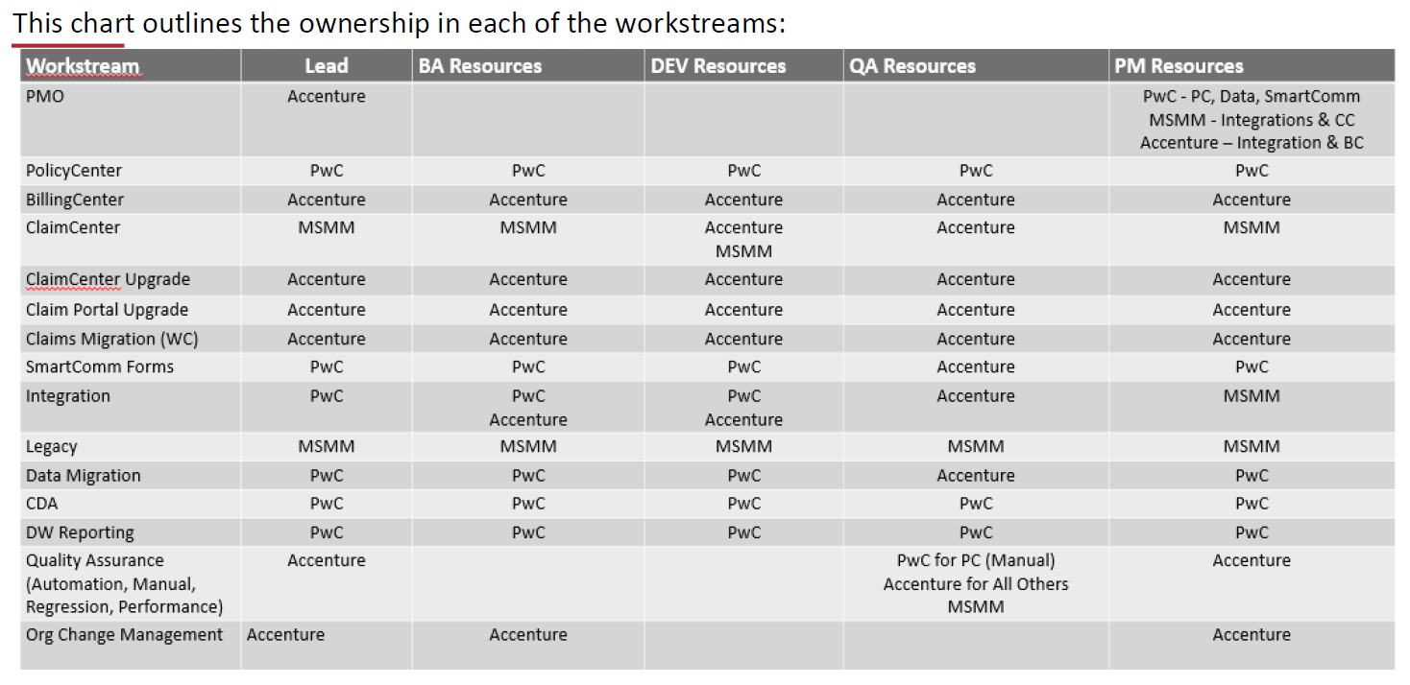
MSIG / RACI

Slide 41
MSIG / R1 Program Level & Automation Strategy (Current)
https://msighusa.sharepoint.com/:w:/s/GuideWireCore/EcPlOqNwyZdKriiMg_0LJUIBGSbHQgs5JoMG7PPqsoh8rw?e=wPw8l7
https://msighusa.sharepoint.com/:w:/s/GuideWireCore/Eb1GgOYPMhhDnoGqeu8Eqw4BZQmPt-fabZiPQC-8rC1RFQ?e=HbkZUI

